Slide 1
HOTEL RESERVATION ANALYSIS
Presented by Snehal Mane for Mentorness in batch MIP-DA-10

Slide 2
OBJECTIVE
Explore the significant findings within the dataset to gain a deeper understanding of guest preferences and pricing trends.
Make informed and strategic decisions based on the insights derived from “ Hotel Reservation ” data.

Slide 3
DATASET DETAILS
The dataset includes the following columns:
Booking_ID: A unique identifier for each hotel reservation.
no_of_adults: The number of adults in the reservation.
no_of_children: The number of children in the reservation.
no_of_weekend_nights: The number of nights in the reservation that fall on weekends.
no_of_week_nights: The number of nights in the reservation that fall on weekdays.
type_of_meal_plan: The meal plan chosen by the guests.
room_type_reserved: The type of room reserved by the guests.
lead_time: The number of days between booking and arrival.
arrival_date: The date of arrival.
market_segment_type: The market segment to which the reservation belongs.
avg_price_per_room: The average price per room in the reservation.
booking_status: The status of the booking.

Slide 4


1. What is the total number of reservations in the dataset?
QUERY
OUTPUT

Slide 5
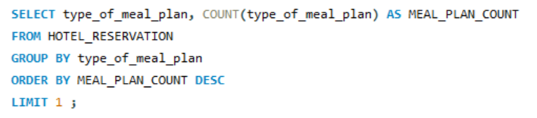

2. Which meal plan is the most popular among guests?
QUERY
OUTPUT

Slide 6
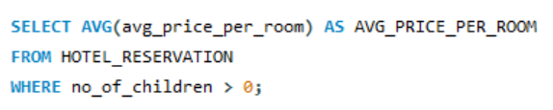

3. What is the average price per room for reservations involving children?
QUERY
OUTPUT

Slide 7
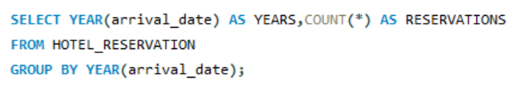

4. How many reservations were made for the year 20XX (replace XX with the desired year)?
QUERY
OUTPUT

Slide 8
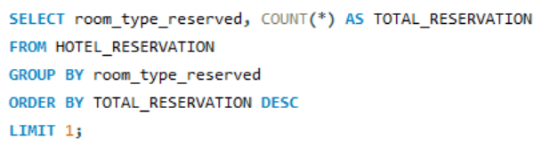

5. What is the most commonly booked room type?
QUERY
OUTPUT

Slide 9
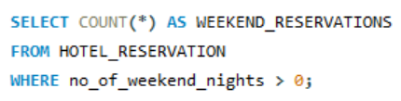

6. How many reservations fall on a weekend (no_of_weekend_nights > 0)?
QUERY
OUTPUT

Slide 10

7. What is the highest and lowest lead time for reservations?
QUERY
OUTPUT

Slide 11
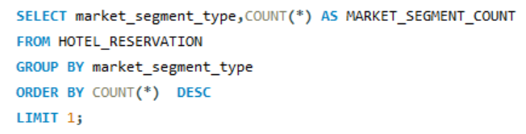

8. What is the most common market segment type for reservations?
QUERY
OUTPUT

Slide 12
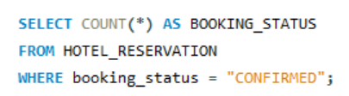

9. How many reservations have a booking status of "Confirmed"?
QUERY
OUPUT

Slide 13

10. What is the total number of adults and children across all reservations?
QUERY
OUTPUT

Slide 14
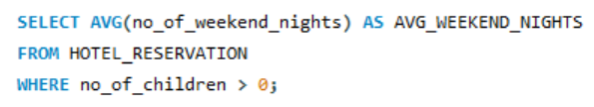

11. What is the average number of weekend nights for reservations involving children?
QUERY
OUTPUT

Slide 15
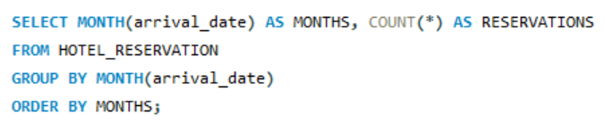
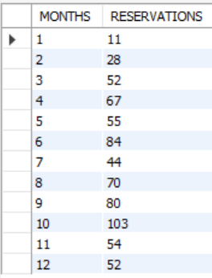
12. How many reservations were made in each month of the year?
QUERY
OUTPUT

Slide 16
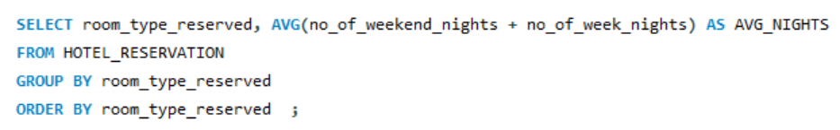
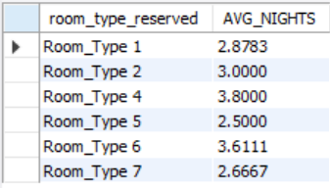
13. What is the average number of nights (both weekend and weekday) spent by guests for each room type?
QUERY
OUTPUT

Slide 17
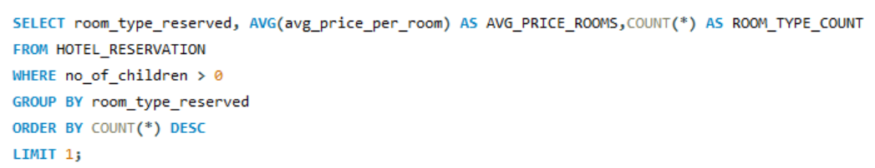

14. For reservations involving children, what is the most common room type, and what is the average price for that room type?
QUERY
OUTPUT

Slide 18
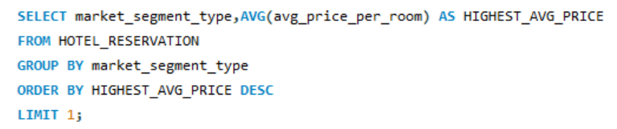

15. Find the market segment type that generates the highest average price per room.
QUERY
OUTPUT

Slide 19
CONCLUSION
Meal_plan 1 was a hit among guests, and Room_type 1 was the top choice for bookings.
The average price per room for reservations with children was 144.56, and the online market segment was the most common.
It's interesting that none of the reservations had a “Confirmed" booking status.
Additionally, it's good to know the details about the lead times, the number of adults and children, and the popular room types.

